Slide 1
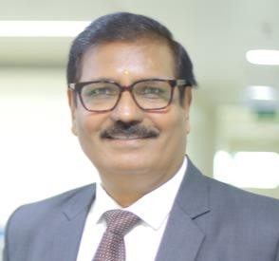
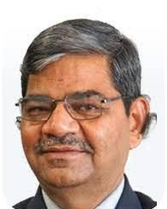
Objective
Committee on Insolvency & Bankruptcy Code The Institute of Chartered Accountants of India (Set up by an Act of Parliament)
Limited Insolvency Examination Preparatory Classroom (Virtual) Program
Good Knowledge about the Code & its process
Brief Outline of the Training Program
Weekday Batch
19th to 23rdJuly 2022
Weekend Batch (Fri & Sat)
5th August 2022 onwards ( Over 5 Weekends)
IBC & REGULATIONS: Introduction
IBC & REGULATIONS: CIRP
IBC & REGULATIONS: Liquidation & Voluntary Liquidation
IBC & REGULATIONS: Resolution and Bankruptcy for Individual & Partnership Firm (Including Personal Guarantors)
IBC & REGULATIONS: Resolution Mechanism for Financial Service Provider (FSP)
Important Court & IBBI Orders
Indian Contract Act & Other Commercial Laws
Limitation Act & Other Securitization laws
Companies Act 2013
Corporate Finance & Constitutional Remedies
CA. Durgesh Kumar Kabra Chairman Committee on Insolvency & Bankruptcy Code, ICAI | CA. Sripriya Kumar Vice-Chairperson Committee on Insolvency & Bankruptcy Code, ICAI | Dr Ashok Haldia Chairman Indian Institute of Insolvency Professionals of ICAI
Fee: Rs 7,500/- + GST | Duration: 40 hours
Online Study Material Available
To Register, click : https://app.iiipicai.in/regpayments/
ICAI members will get 15 structured CPE hours
Email: ipprogram@icai.in Ph: 8178995141
Limited
Seats
Website:
https://www.iiipicai.in
Last date to Register: One day prior to respective batch

